Slide 1
Communication between cells
Communication occurs by two main methods:
Nervous system (nerve impulses)
Endocrine system (hormones)

Slide 2
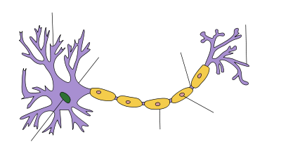
Nervous communication
Nerve cell (neuron)
Target cell
Nerve impulses
Sensory neurones
Relay neurones
Motor or effector neurones
End of nerve cell
Effector is usually a muscle or gland

Slide 3
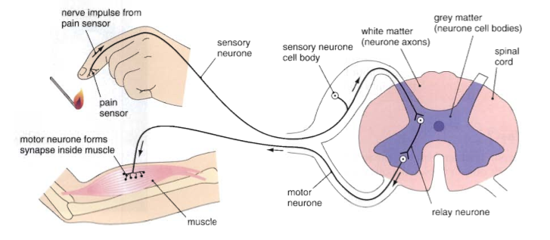
Nervous communication
Communication occurs when the nerve cell directly signals the target cells – muscles or glands. This is a quick and efficient method and is the favoured method if a quick response is required

Slide 4
Hormonal Communication (Endocrine system)
Receptor on target cell for hormone
Hormone travels in blood to the target cell
Blood system
Cell in endocrine gland
Target cell

Slide 5
Hormonal Communication
Communication occurs when the endocrine gland produces a hormone and this is sent to the target cell via the blood system. This tends to be a slower response and is frequently used for growth and development of the organism. The main exception is adrenalin, where is prepares the body for an emergency.

Slide 6
Hormones =
They are produced by the endocrine system and act as “chemical messengers” transported in the blood

Slide 7
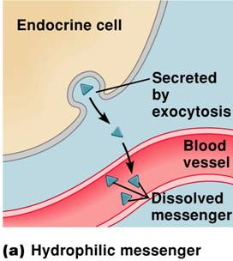

Slide 8
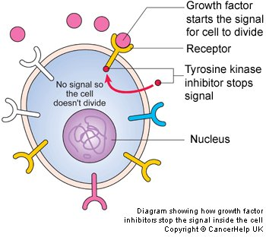

Slide 9
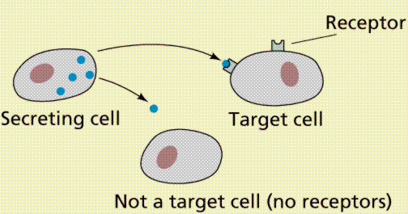

Slide 10
Endocrine system
Hormones are chemical substances produced by one part of the body (endocrine gland) which have and effect n another part (target cells)
There are two types of glands:
Glands with ducts
(exocrine glands)
e.g. glands that secrete digestive
enzymes (salivary gland)
Ductless glands
(endocrine glands)
e.g. glands which secrete
hormones (pituitary gland (ADH))
duct
Hormone diffuses into blood stream
Blood vessel

Slide 11
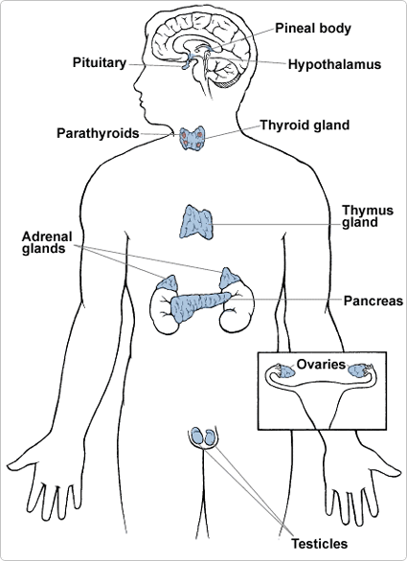
So far you have looked at the effect of the following hormones
ADH
Insulin
Secretes ADH, human growth hormone &
trophic hormones (control other endocrine glands)
The pancreas is also an exocrine organ – it secretes enzymes for digestion down a tube into the small intestine
Secrete adrenalin
“fight or flight” hormone
Secretes insulin
Secrete oestrogen & progesterone
Secrete testosterone

Slide 12
Hormones
You need to know about the following:
Adrenalin – “fight or flight” hormone secreted from the adrenal glands
Testosterone, Oestrogen and Progesterone (sex hormones to be covered later)

Slide 13
Hormones | Gland which secretes it | When secreted | Function
ADH | Pituitary gland | When blood water potential is low | Allows collecting ducts to reabsorb more water by osmosis back into blood
Insulin | Pancreas | When blood glucose levels are high | Allows the liver to absorb glucose and convert to glycogen
Adrenalin | Adrenal glands | In an emergency Danger Excitement | Increases the rate of aerobic respiration
Testosterone | Testes | From puberty onwards | Develop secondary sexual characteristics Sperm production
Oestrogen | Ovary | From puberty onwards | Develop secondary sexual characteristics Development of the uterine wall Prevent FSH production
Progesterone | Corpus luteum | After ovulation and during pregnancy | Maintenance of the uterine wall Prevention of FSH production

Slide 14
Adrenalin
Most hormones produce their effects rather slowly, bringing about long term changes in the body, such as growth, sexual development. However, adrenalin acts fast and prepares the body for action. It is often called the “fight or flight” hormone.
Effects of adrenalin include
Increase in blood glucose concentration (respiratory substrate)
Heart beats fast and with greater force
Rate of breathing increases
Blood vessels in the muscles widen increasing flow (vasodilation)
Blood vessels in the gut and near the skin constrict (vasoconstriction)

Slide 15
Adrenalin
Explain the benefits of the responses caused by adrenalin
Adrenalin prepares the body for an emergency and so increase in energy from aerobic respiration
glucose + oxygen → carbon dioxide + water
Increased heart rate & strength ensures respiratory substrates arrive quickly to muscles and waste products are efficiently removed.
More glucose released back into blood from glycogen stores in the liver – raising conc. of respiratory substrate
Increased breathing rate ensures more oxygen gets to muscles
Increased breathing rate ensures CO₂ is quickly removed

Slide 16
Hormones and Sport
Athletes can improve their performance with the use of hormones. Although this is strictly illegal and may be harmful, some athletes are willing to take the risk in pursuit of sporting success.
Why might an athlete take adrenaline?
What effects would it cause in their body?
What harm could it cause to the body?

Slide 17
Adrenaline and Sport
If taken it will give immediate improved performance especially in ‘power’ events such as sprinting
It could cause an increase in blood pressure which may be harmful to blood capillaries

